Slide 1
Tile38
Cireneu Araújo

Slide 2
What is it?
Ultra Fast Geospatial Database & Geofencing Server
Open source
Written in Go
Store and query with real-time spatial data
Created by Todd Nine (Heroku Engineer) - 2016
Performance, concurrency and portability.

Slide 3
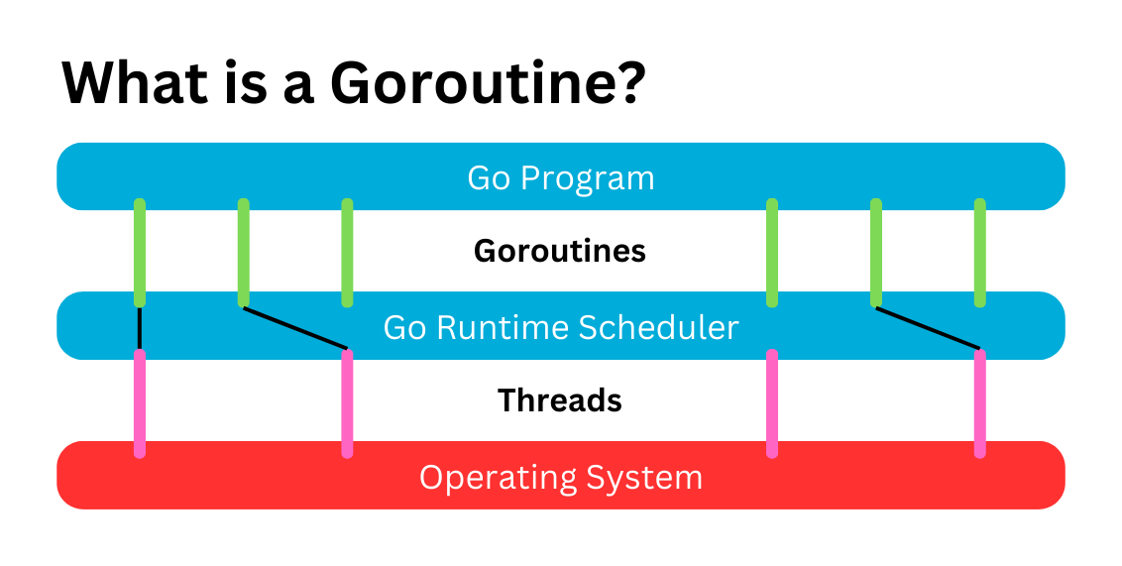
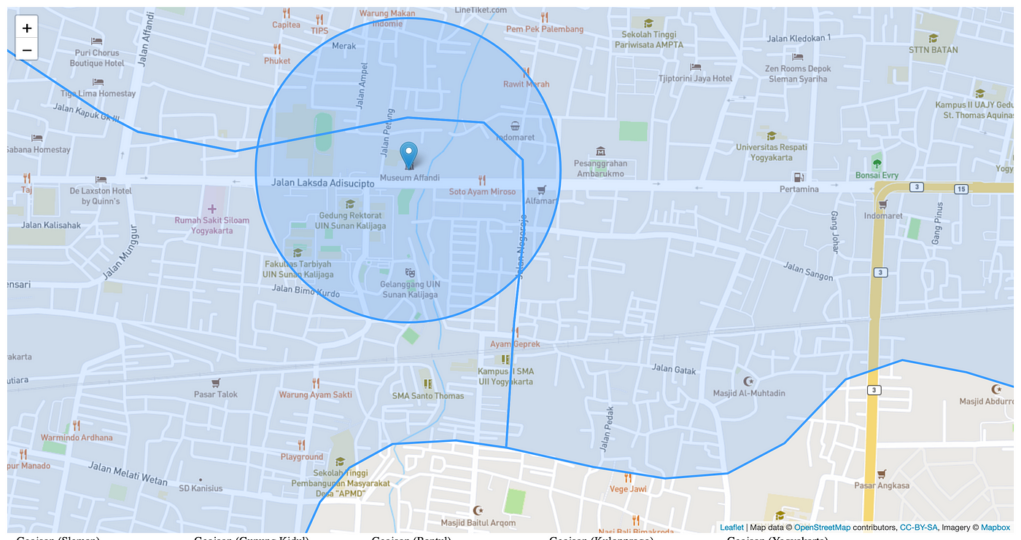
Main features
Concurrency
Points, polygons, lines, circles, bounding boxes.
Real-time geofencing
Webhooks and Websocket

Slide 4



Similar Tools
PostGIS
Redis + RedisGeo
MongoDB Support for geolocation

Slide 5
PROS and CONS
PROS
Lightweight and easy to deploy
High real-time performance
Easy to use with Redis-like commands
CONS
Limited persistence
Horizontal scalability
Fewer analytical features

Slide 6
Bibliography
01
https://medium.com/%40frederic.rodrigo/pbf2redis-eae7fcada735
02
https://tile38.com/topics/installation
03
https://github.com/phulst/node-tile38

Slide 7

Questions?

